Slide 1




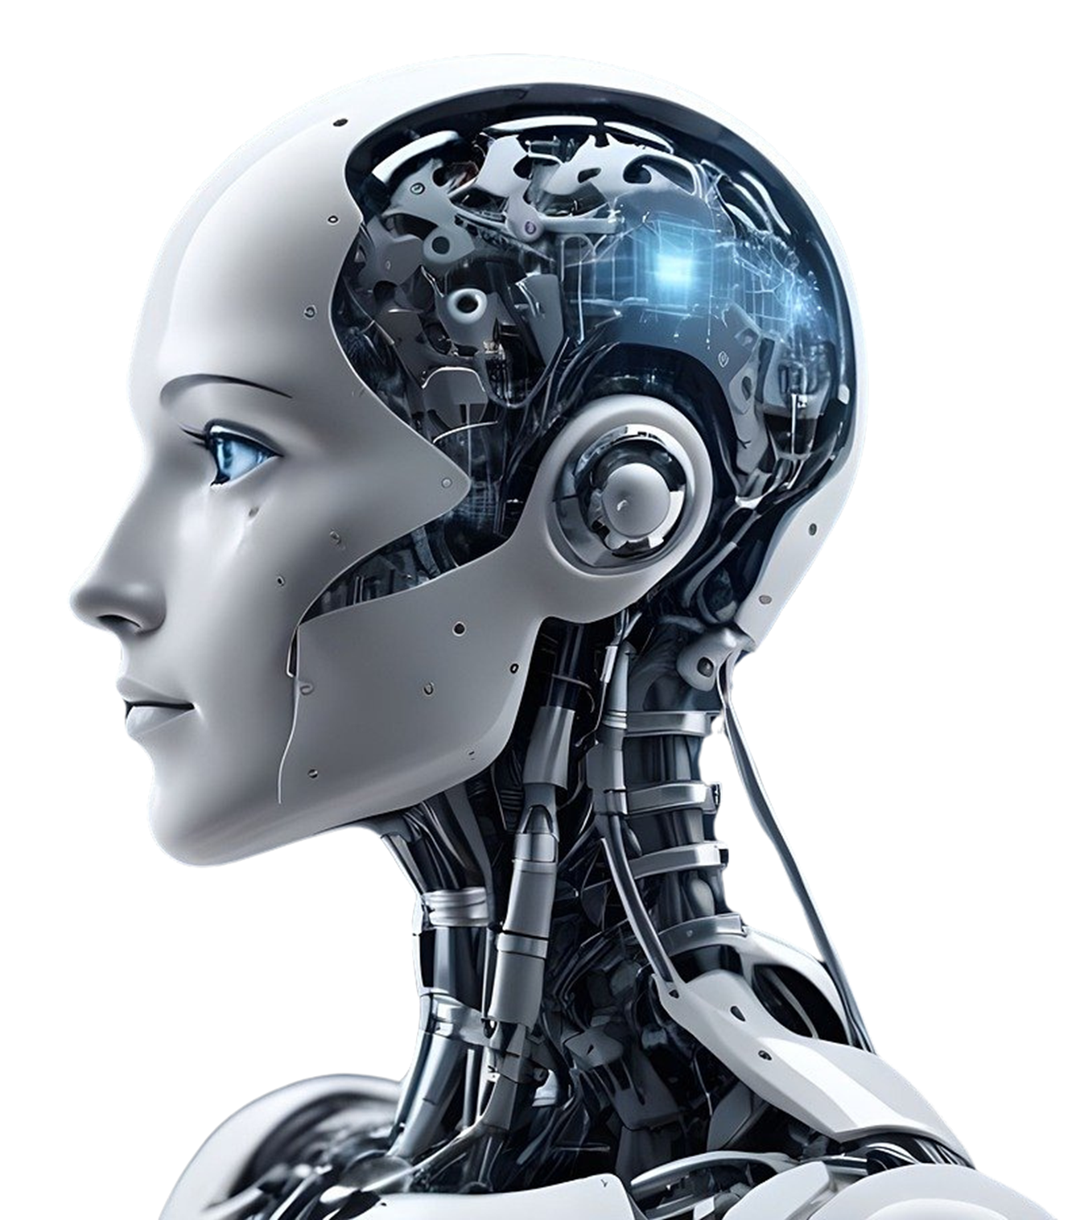


Voice Assistant Using Python
Powered by Gemini API & Google Generative AI
Presented by: Shubham Chaurasia

Slide 2


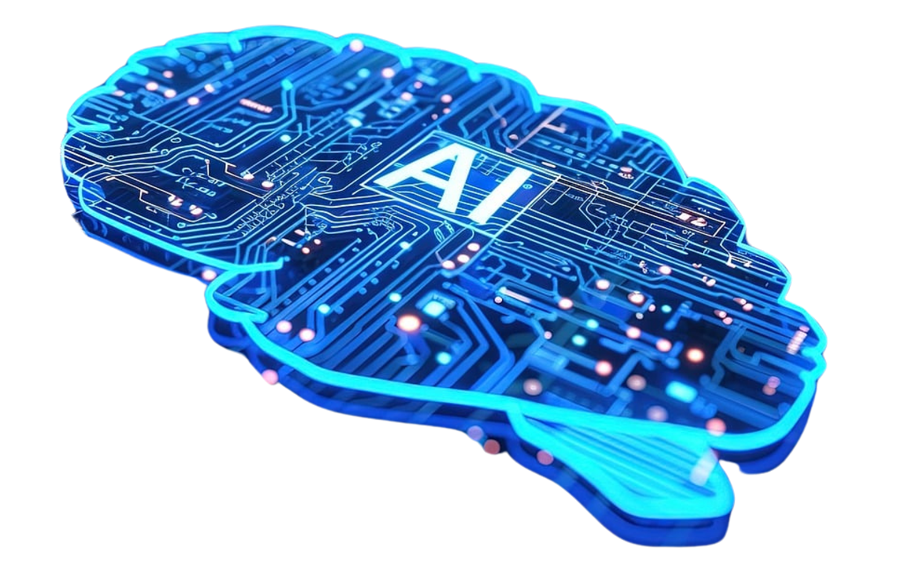

INDEX
Introduction
Technologies Used
Features of the Voice Assistant
Code Modules Overview
Flow of Execution
Code Snippet Highlights
Use Cases
Future Enhancements
Conclusion

Slide 3

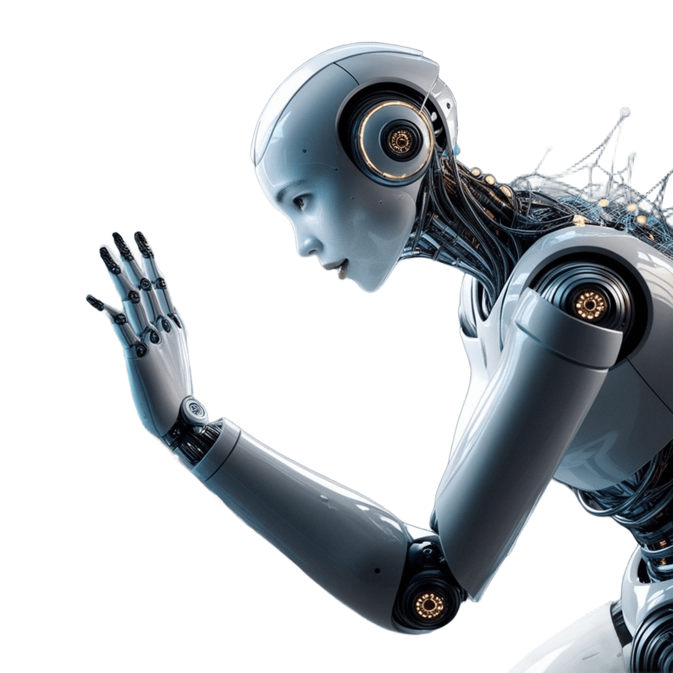
INTRODUCTION
Objective: Create a voice assistant that can interact,
tell jokes, open websites, and generate emails.
Technologies Used:
Speech Recognition (speech_recognition)
Text-to-Speech (pyttsx3)
Web Automation (webbrowser)
AI APIs (google.generativeai, openai)

Slide 4


Features of the Voice Assistant
. Voice-based interaction with the user
. Opens popular websites like YouTube, Google, and Twitter
. Tells current time and jokes
. Generates email content using Generative AI
. Plays music from a specified path

Slide 5
Code Modules Overview
1. Speech Recognition (take_command) : Listens to user commands
2. Text-to-Speech (say) : Converts response text to speech
3. Website Handling (open_website) : Opens websites using the browser
4. Time Function (tell_time) : Announces the current time
5. Joke Teller (tell_joke) : Fetches a random joke
6. Email Generator (generate_email) : Creates AI-generated email content

Slide 6
Flow of Execution
1. Initialization: Greets user with 'Hello, I am Alexa.'
2. Input: User provides a voice command (recognized by take_command)
3. Processing: Based on the command:
Opens websites
Provides time or jokes
Generates an email if asked
4. Output: Responds via speech or action
5. Exit Condition: If the user says 'exit' or 'quit'

Slide 7

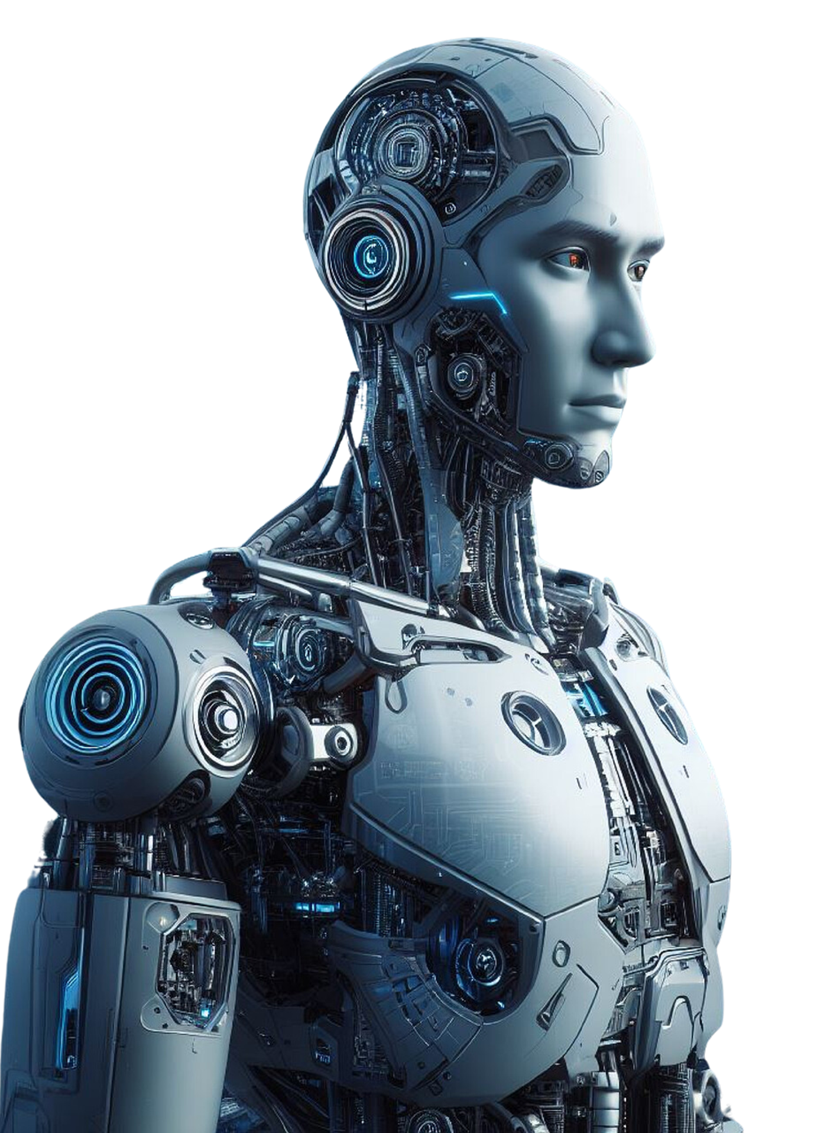


Code Snippet Highlights
. Chat Function:
def chat(query):
global chatStr
chatStr += f"Shubham: {query}\n Alexa: "
response = genai.generate(prompt=chatStr, **generation_config)
reply = response.generations[0].text
say(reply)
return reply

Slide 8
Code Snippet Highlights
2. Email Generation:
def generate_email(query):
model = genai.GenerativeModel(model_name="gemini-1.5-flash")
chat_session = model.start_chat(...)
response = chat_session.send_message(query)
say("Here is the email content that I have generated.")
print(response.text)

Slide 9

Use Cases
Personal AI assistant for daily tasks
Email automation for professionals
Hands-free operation for accessibility

Slide 10

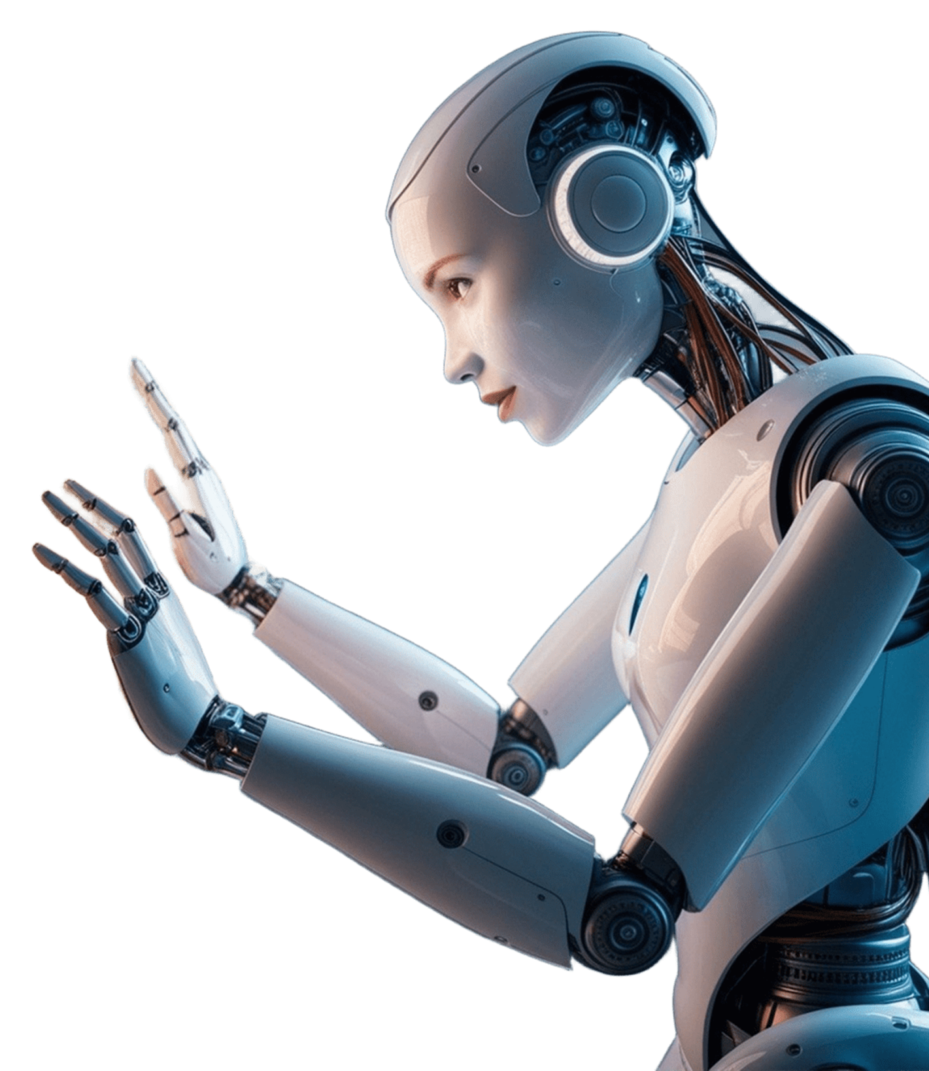
Future Enhancements
Add more website integrations
Enable better conversation memory management
Include more dynamic responses with improved context understanding
Add support for controlling IoT devices

Slide 11

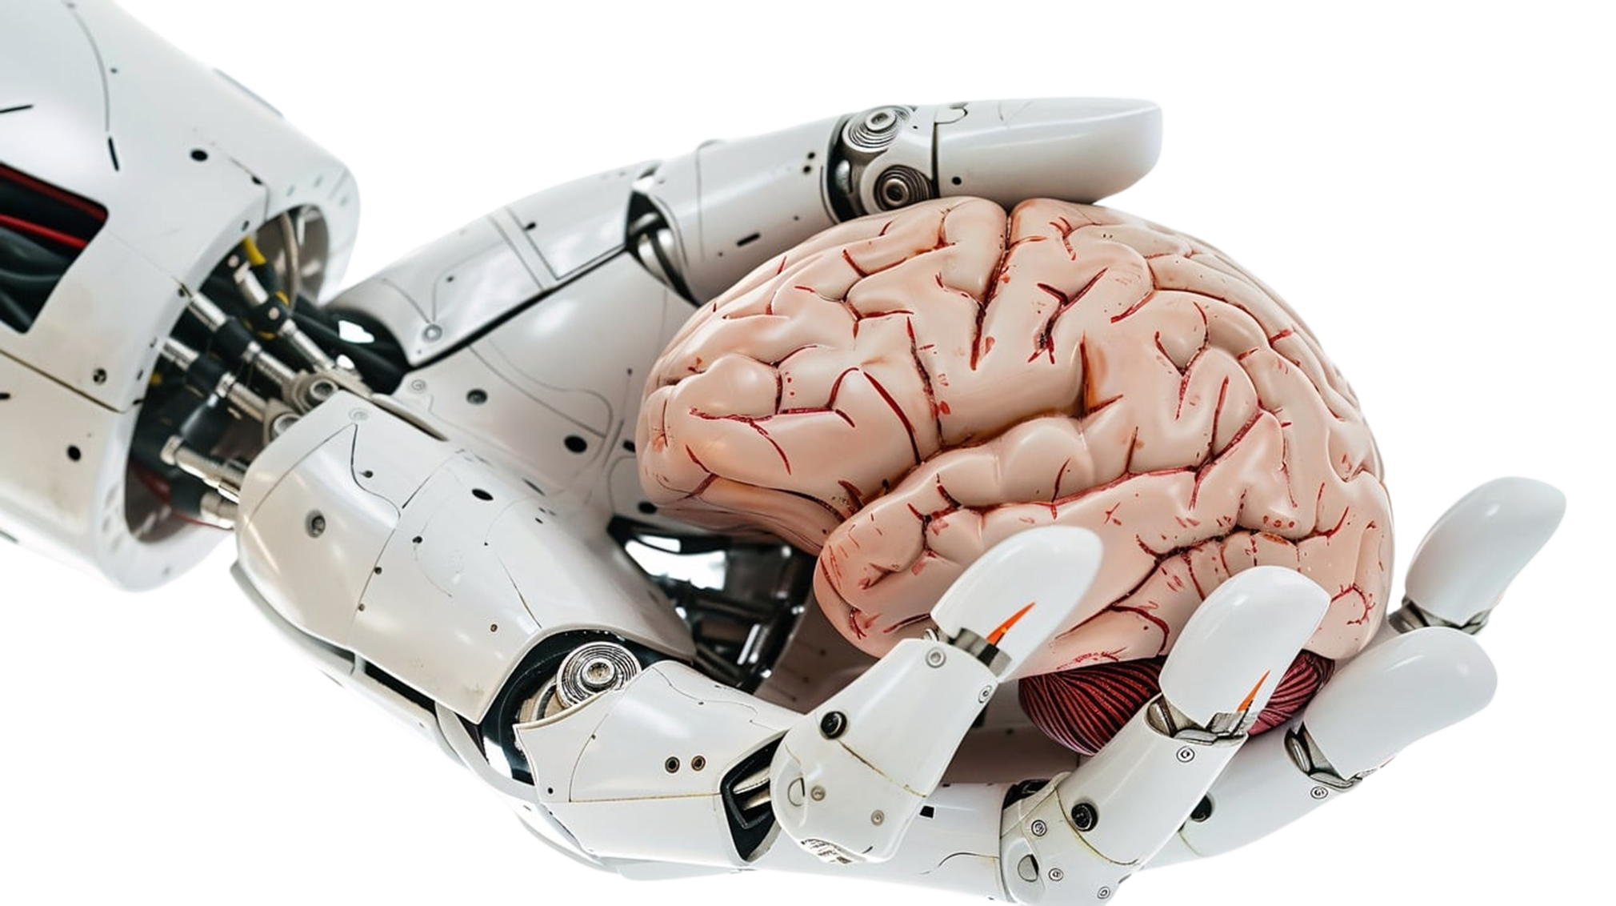

CONCLUSION
This voice assistant combines traditional web automation and cutting-edge generative AI.
It can handle multiple tasks through voice commands, showcasing AI's versatility.

